Slide 1


[Social Buzz Content Analysis]

Slide 2


Today's agenda
Project recap
Problem
The Analytics team
Process
Insights
Summary

Slide 3

Social Buzz is a Social media & content creation fast growing
platform that needs adaptation to it’s global scale.
Accenture has begun a 3 month initial project focusing on
these tasks:
1. An audit of Social Buzz’s big data practice
2. Recommendations for a successful IPO
3. Analysis to find Social Buzz’s top 5 most popular
categories of content.
Project Recap

Slide 4


Over 1,00,000 posts per day
36,500,000 pieces of content per year!
But how to capitalize on it when there is so much
content?
Analysis to find Social Buzz’s top 5 most popular
categories of content.
Problem

Slide 5



Andrew Fleming
Chief Technical Architect
The Analytics team
Marcus Rompton
Senior Principle
Ujjwal Kumar
Data Analyst

Slide 6
Process
1
Data Understanding
2
Data Cleaning
3
Data Modelling
4
Data Analysis
5
Uncover Insights

Slide 7

Insights
16
1897
MAY
DISTINCT
CATEGORIES
REACTIONS TO ANIMAL
CATEGORY
MONTH WITH
MOST POST

Slide 8
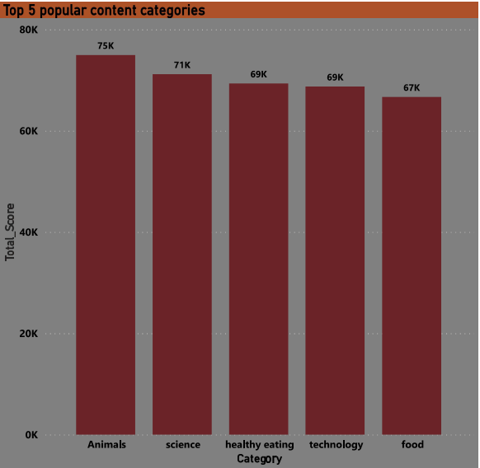
Top 5 Categories with High Popularity

Slide 9
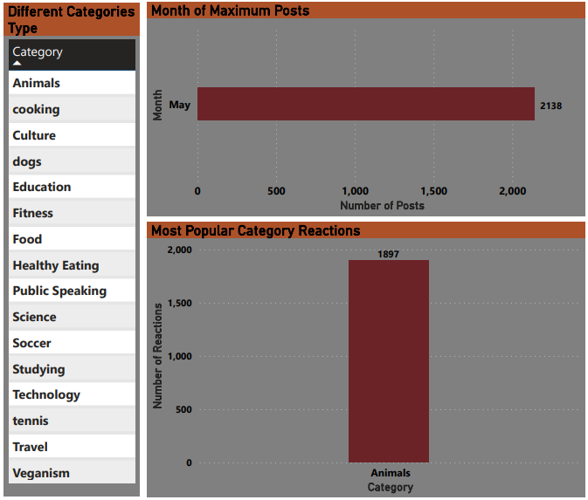
Distinct Categories with Month of Maximum Posts and Reactions Count of Most Popular Category

Slide 10

ANALYSIS
Animals and Science are two most popular categories
of content that represent people are enjoying nature
and scientific phenomenon content the most.
INSIGHT
Healthy Eating is one of the most popular category in
your user base with Food category as well. You can
initiate various campaign and initiative with respect
To Healthy Eating brand to boost your user experience.
Summary
NEXT STEPS
This ad-hoc analysis is insightful, but it’s time to
expand to large scale about your real valuation
of business. We Can show you how to do this.

Slide 11

Thank you!
ANY QUESTIONS?

